Slide 1
TenCENT Take Home Challenge
User Profile and Topline Metics

Slide 2
User profile
Insights and AB testing reports

Slide 3
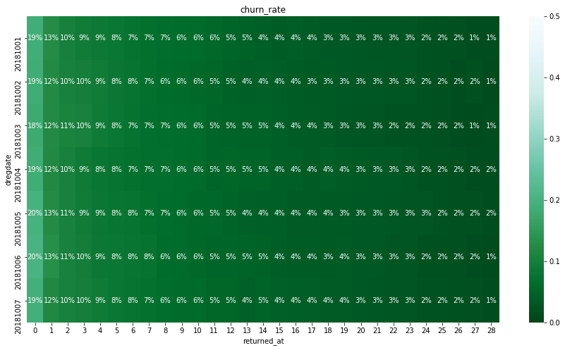
Recap the game Platform (Visiting Volume Tracking)
Experiments period crossed 7 registered day and tracked their changes cross all 28 days.
There is no significantly difference between when the experiment starts.
About 20% volume happened on the registered day and volume dropped to 9% on the day 4. It is a novelty effect which is the tendency for performance to initially improve when new technology is issued.
Second volume shift happened from day 5 to day 11, which dropped from 8% to 5%. Third shift happened on day 12 – day 21 from 5% to 3%. This period is a plateau of volume growth.
After day 22, the visitor volume is equal and less than 2%.

Slide 4
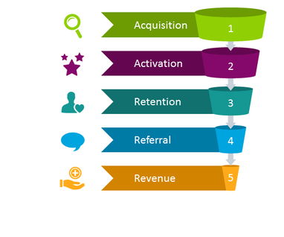
Review AB Testing Result
Before start doing AB Testing Result review, we need define the suitable metric on different stages.
Our experiment is based on the session level.
There are 4 variation: each variant got same distribution split:
A: 30%
B: 25%
C: 25%
Control:20%
Because “user profile” data starts from the day user registered, I will start from ‘Activation’ step among AARRR funnel and not any referral information in the dataset. I am going to ignore it for now. Here are key metrics for each funnel stage.
Activation & Retention both related customer engagement. Here I picked time stay in the app on current day as our key metric to evaluate the efficiency of customer engagement.
Time spend on current day
Revenue :
Spending Amount on current day

Slide 5
Data Cleaning and few business assumption:
1. Adding User_ID to the table.
Due to registered information will not changed over time. I concatenated ‘vgameappid’ and ‘vopenid’ as user id of this table.
2. Clean up the systerm hardware information
substring the brand of the systerm hardware
substring the device type of the systerm hardward
3. User Activity information:
Calculated the total active days per user
Recognize if customer start active since the registered day, which means their earliest active date is same as the registered date.
4. Generate new variable ‘Time stay in the app on current day’ by 'ionlinetime'
As expected, ionlinetime should monotonic with dtstatdate increasing. But many online stay time not presented correctly. After aggregated to customer level, there are 13.6% customers have invalid time on the app.
Monetarization variable (itimes vs iamount):
There are 394 sessions present itimes > 0, which means user make payments. However, if we check the amount they paid, 163 out of 394 sessions have positive payment amount.
There are two possible reason:
iamount didn’t record the real payment in correct way. It need be imputed by other value such as mean or median. However if 66% of missing value need be imputed by 33% value. It will cause huge bias.
Itimes counted payments is one process of the whole payment flow.
When I doing the monetarization decision, I will use ‘iamount >0’ as the converted flag.

Slide 6
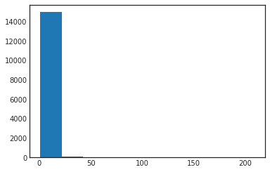
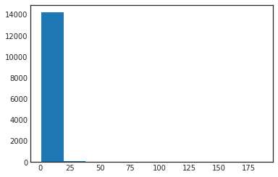

Time spend on current day (Engagement Success)
Time Spend on current day
Time Spend on current day
Time Spend on current day
Variation A
Variation B
Variation C
Basic Info for time spend
count | 204,795
mean | 7,378
std | 7,784
min | -
10% | 367
25% | 1,735
50% | 4,832
75% | 10,643
max | 86,400
Time spend for all variation is binominal distribution.
Avg time spend for A: 7,372 (vs control group) Z-score: -26.80. P-value: 1.00
Avg time spend for B: 7,397 (vs control group) Z-score: -14.58. P-value: 1.00
Avg time spend for C: 7,374 (vs control group) Z-score: -14.74 P-value: 1.00
Avg time spend for Control: 7,370
No. of total cases 204,795

Slide 7
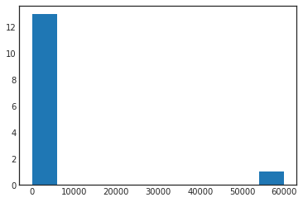
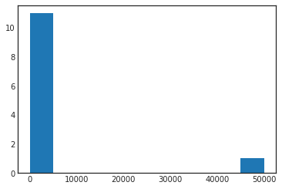

Spending Amount on current day (Monetarization Success)
There are some simulation records generated by device brand is ‘Tencent’, which not create any spending activities. So I removed them from the testing dataset.
Spending Amount on current day
Spending Amount on current day
Spending Amount on current day
Variation A
Variation B
Variation C
Time spend for all variation is binominal distribution.
Avg time spend for A: 0.50 (vs control group) Z-score: 0.0057 P-value: 0.498
Avg time spend for B: 0.45 (vs control group) Z-score: 0.0377 P-value: 0.485
Avg time spend for C: 0.49 (vs control group) Z-score: 0.0828 P-value: 0.467
Avg time spend for Control: 0.33
No. of total cases 204,795

Slide 8
Business Insights

Slide 9
Insights on User Profile Metrics (1/3)
Number of Visits within 28 days | Sum of num_users | Sum of num_users2
1 | 129,189 | 82%
Do not do any visit on the registered day | 108,002 | 84%
Did same day visit on the register day | 21,187 | 16%
2 | 10,078 | 6%
Do not do any visit on the registered day | 7,739 | 77%
Did same day visit on the register day | 2,339 | 23%
3 | 4,767 | 3%
Do not do any visit on the registered day | 3,282 | 69%
Did same day visit on the register day | 1,485 | 31%
4 | 3,124 | 2%
Do not do any visit on the registered day | 2,332 | 75%
Did same day visit on the register day | 792 | 25%
5 | 2,046 | 1%
Do not do any visit on the registered day | 1,331 | 65%
Did same day visit on the register day | 715 | 35%
6 | 1,661 | 1%
Do not do any visit on the registered day | 913 | 55%
Did same day visit on the register day | 748 | 45%
More Than 5 times visits | 5,764 | 4%
Do not do any visit on the registered day | 3,113 | 54%
Did same day visit on the register day | 2,651 | 46%
Grand Total | 156,629 | 100%
People who come visited our app on the registered day, lean to be more active user with the first month.
For future engagement, we could focus on the group who start playing game in the registered day. Meanwhile, we could track the user behavior on this group to evaluate the success of acquisition.

Slide 10
Insights on User Profile Metrics (2/3)
# Activiation Days within 28 days | Number of users | User %
1 | 129,189 | 82%
2 | 10,078 | 6%
3 | 4,767 | 3%
4 | 3,124 | 2%
5 | 2,046 | 1%
6 | 1,661 | 1%
7 | 1,375 | 1%
8 | 1,023 | 1%
9 | 858 | 1%
More than 10 | 2,508 | 2%
By using
Total number of customer is 156,629.
Checking their visiting activity distribution:
82% customers visited our app only once with 28 days. 6% users visited twice and 3% users visited three times.

Slide 11
Predication Model development
For understanding how monetarization happened, I used ‘Paid_Customer’ as a flag to look other variables.
Due to device brand is highly related to users’ affordable ability, I looked the phone brand.

Slide 12
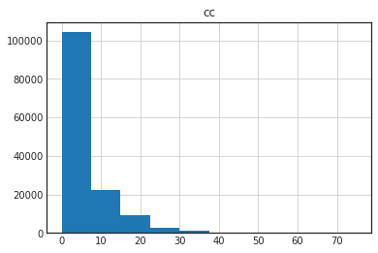
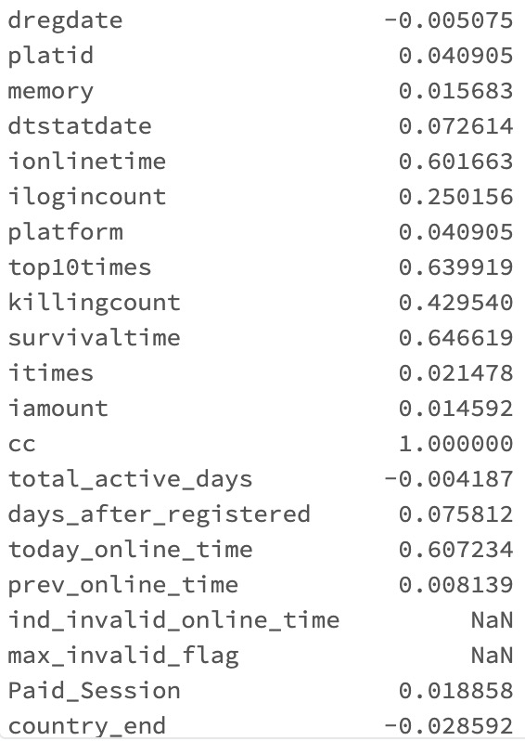
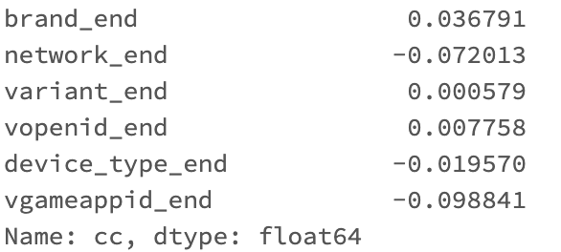
Predicate ‘CC’ (total games on certain date)
Bivariate Analysis between target variable:

Slide 13
Feature Engineering
Drop low correlation variable
Drop collinearity variables
Using Random forest variable important as the other method to run through next iteration feature engineering
Take log() on bias variables.
One-hot decoding for character variables, which prepare the inputs for the following regression ML models.

Slide 14
Hyperparameter grid & Cross validation
For random forest, focus on tunning number of trees and max of depth, which could control how tree built.
paramGrid = ParamGridBuilder() \
.addGrid(rf.numTrees, [int(x) for x in np.linspace(start = 10, stop = 50, num = 3)]) \
.addGrid(rf.maxDepth, [int(x) for x in np.linspace(start = 5, stop = 25, num = 3)]) \
.build()
Train/Test split:
Used 70% , 30% split for training and testing dataset.

Slide 15
Result
Output for Random Forest:
Root Mean Squared Error (RMSE) on test data = 4.15218
Output for regular regression with Lasso penaty:
Mean squared error: 19.690202
RMSE: 4.437364
Multiple R-squared: 0.545831

Slide 16
Other potential user case for profile data
Clustering the customer into paid customer and regular customer.
Potential issue is the paid user is very small partial of total user population.
Use SMOTE could solve it but only apply to training dataset.

Slide 17
Topline Metrics
Graph Analysis

Slide 18
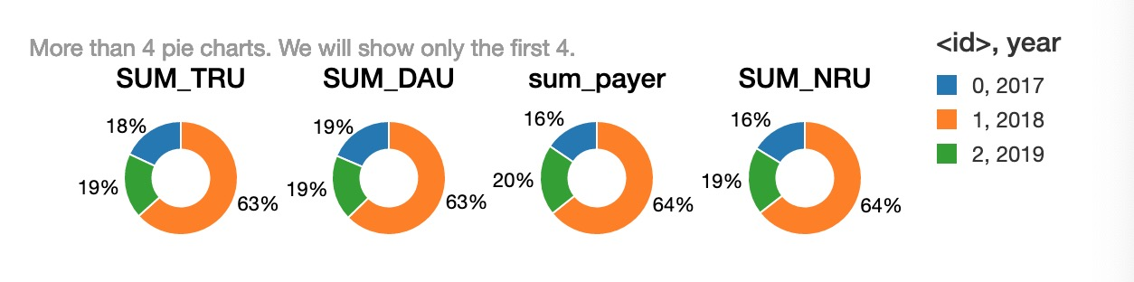
Topline data: Graph Causality Analysis
Overall, compare to 2017 and 2019, all variables in 2018 have much higher volume than others.

Slide 19
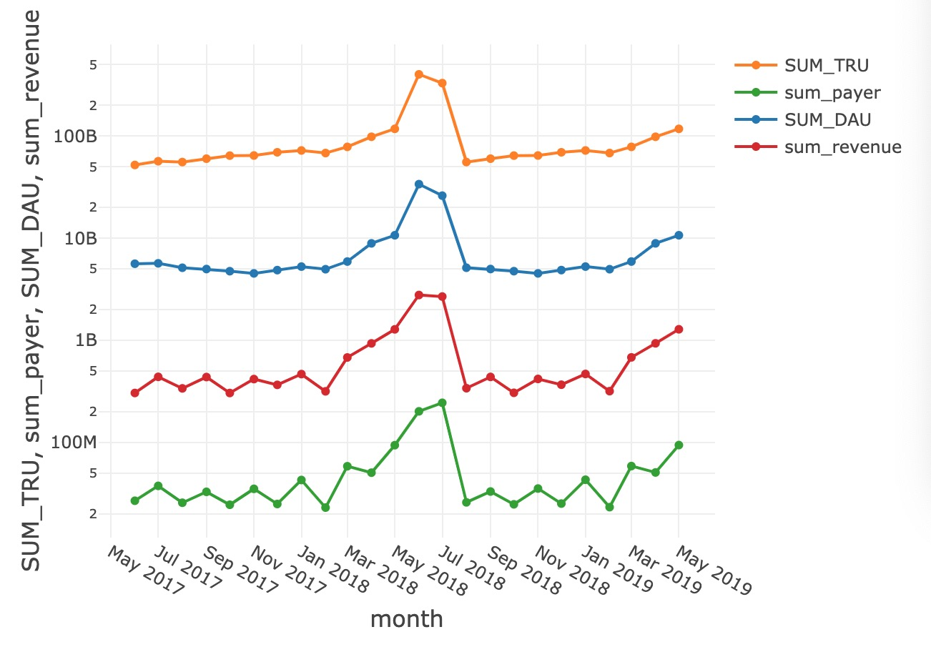
Graph Causality Analysis
Engagement Metrics:
Dig into more details, TRU and DAU share same trend. Anomaly populated on Mar,2018 to July,2018.
Monetarization Metrics:
Total number of payer and revenue, are both waved moving before Mar,2018. The rapidly growth happened till Jul,2018.

Slide 20
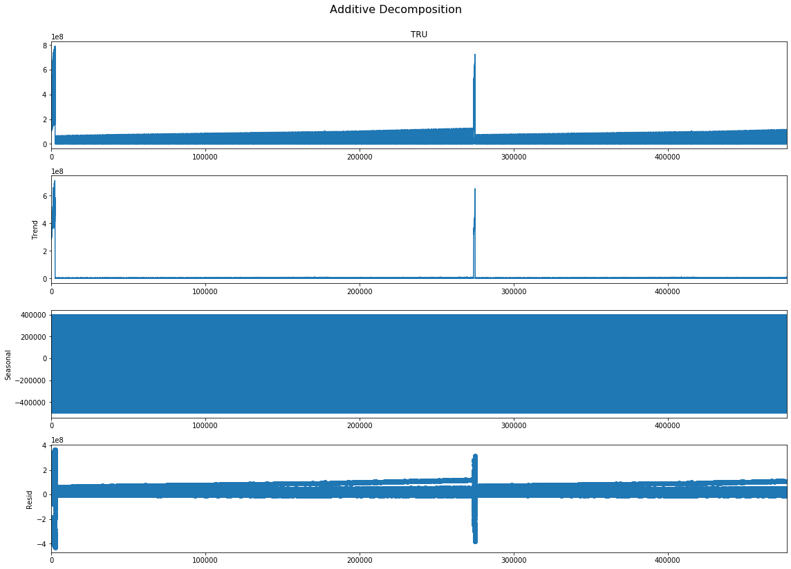
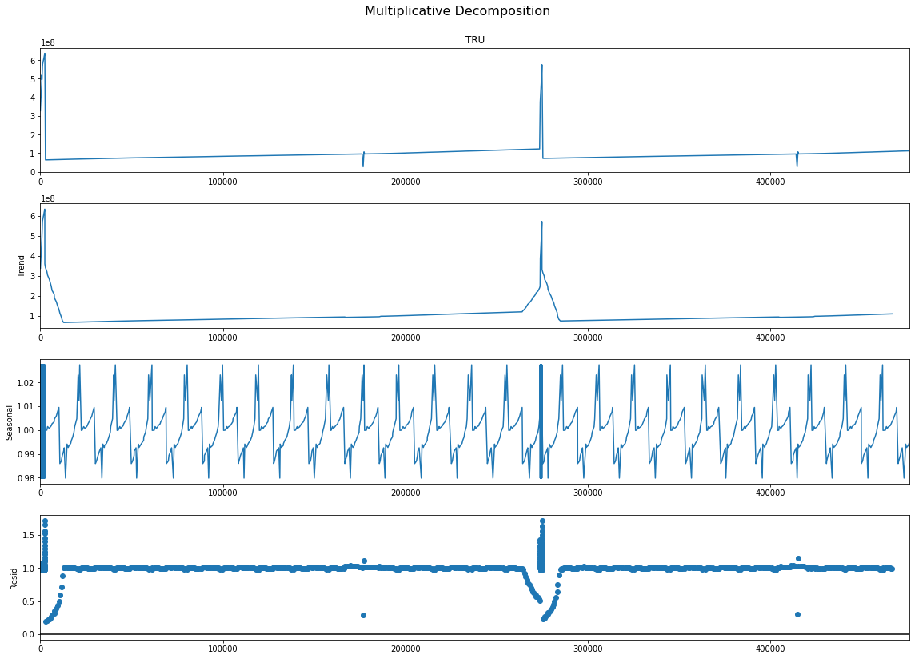
Time Series Graph Chart

Slide 21
Anomaly Detection
Supervised learning:
Based on the historical data to forecast the value and add the confidential interval. Once future data is out of the stable zone will be recognized as Anomaly
I used the
Unsupervised Learning:
Using clustering automatically assign them into anomaly group vs not
By using density-based modeling or distance based modeling skill

Slide 22
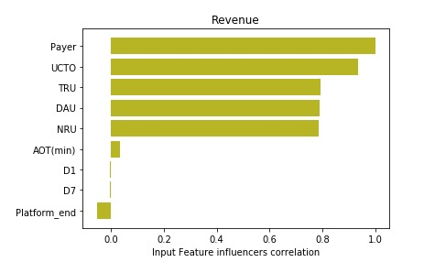
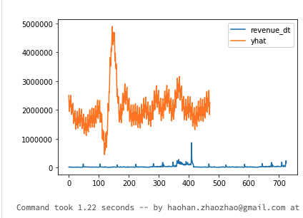
Supervised Learning for Anomaly Detection
prophet_basic = Prophet(
interval_width=0.95,
growth='linear',
daily_seasonality=False,
weekly_seasonality=True,
yearly_seasonality=True,
seasonality_mode='multiplicative'
)
Due to limited time, I only run out the baseline forecasting model by Prophet. The performance looks far away from expected.

